Slide 1


Computer Networks
Week9_Lecture2 (Chapter3)
Transport Layer
Subhan Ullah, PhD
subhan.ullah@nu.edu.pk
BS(Computer Science) Spring-2024

Slide 2

Chapter 3: roadmap
Transport-layer services
Multiplexing and demultiplexing
Connectionless transport: UDP
Principles of reliable data transfer
Connection-oriented transport: TCP
Principles of congestion control
TCP congestion control
Evolution of transport-layer functionality

Slide 3
rdt3.0: channels with errors and loss
New channel assumption: underlying channel can also lose packets (data, ACKs)
checksum, sequence #s, ACKs, retransmissions will be of help … but not quite enough
Q: How do humans handle lost sender-to-receiver words in conversation?

Slide 4

rdt3.0: channels with errors and loss
Approach: sender waits “reasonable” amount of time for ACK
retransmits if no ACK received in this time
if pkt (or ACK) just delayed (not lost):
retransmission will be duplicate, but seq #s already handles this!
receiver must specify seq # of packet being ACKed
use countdown timer to interrupt after “reasonable” amount of time
timeout

Slide 5
rdt3.0 sender
rdt_send(data)
sndpkt = make_pkt(0, data, checksum)
udt_send(sndpkt)
start_timer
Wait for
call 0 from above
Wait for ACK0
rdt_rcv(rcvpkt)
&& notcorrupt(rcvpkt)
&& isACK(rcvpkt,1)
rdt_rcv(rcvpkt)
&& notcorrupt(rcvpkt)
&& isACK(rcvpkt,0)
stop_timer
stop_timer
Wait for ACK1
Wait for
call 1 from above
rdt_send(data)
sndpkt = make_pkt(1, data, checksum)
udt_send(sndpkt)
start_timer
Notes:
We see the familiar four state sender from our rdt 2.1 and 2.2 protocols. Top two states when sending packet with zero seq # and bottom two

Slide 6
rdt3.0 sender
rdt_send(data)
rdt_rcv(rcvpkt) &&
( corrupt(rcvpkt) ||
isACK(rcvpkt,1) )
sndpkt = make_pkt(0, data, checksum)
udt_send(sndpkt)
start_timer
rdt_rcv(rcvpkt)
Λ
Λ
Wait for
call 0 from above
Wait for ACK0
timeout
udt_send(sndpkt)
start_timer
rdt_rcv(rcvpkt)
&& notcorrupt(rcvpkt)
&& isACK(rcvpkt,1)
rdt_rcv(rcvpkt)
&& notcorrupt(rcvpkt)
&& isACK(rcvpkt,0)
stop_timer
stop_timer
Wait for ACK1
Wait for
call 1 from above
timeout
udt_send(sndpkt)
start_timer
rdt_rcv(rcvpkt)
rdt_send(data)
Λ
rdt_rcv(rcvpkt) &&
( corrupt(rcvpkt) ||
isACK(rcvpkt,0) )
sndpkt = make_pkt(1, data, checksum)
udt_send(sndpkt)
start_timer
Λ
Notes:
We see the familiar four state sender from our rdt 2.1 and 2.2 protocols. Top two states when sending packet with zero seq # and bottom two

Slide 7

rdt3.0 in action
sender
receiver
sender
receiver
send pkt0
pkt0
send pkt0
pkt0
rcv pkt0
rcv pkt0
ack0
send ack0
ack0
send ack0
rcv ack0
rcv ack0
send pkt1
pkt1
send pkt1
pkt1
rcv pkt1
X
ack1
send ack1
loss
rcv ack1
send pkt0
pkt0
rcv pkt0
timeout
resend pkt1
ack0
send ack0
pkt1
rcv pkt1
ack1
send ack1
rcv ack1
send pkt0
pkt0
(a) no loss
rcv pkt0
ack0
send ack0
(b) packet loss

Slide 8
rdt3.0 in action
sender
receiver
sender
receiver
send pkt0
pkt0
rcv pkt0
send pkt0
pkt0
send ack0
rcv pkt0
rcv ack0
ack0
ack0
send ack0
send pkt1
pkt1
rcv ack0
rcv pkt1
send pkt1
pkt1
send ack1
rcv pkt1
ack1
ack1
send ack1
X
timeout
resend pkt1
loss
pkt1
rcv pkt1
timeout
resend pkt1
rcv ack1
(detect duplicate)
pkt1
rcv pkt1
send ack1
send pkt0
pkt0
ack1
(detect duplicate)
rcv pkt0
rcv ack1
send ack1
rcv ack1
ack1
ack0
send ack0
send pkt0
pkt0
(ignore)
rcv pkt0
ack0
send ack0
pkt1
(c) ACK loss
(d) premature timeout/ delayed ACK

Slide 9
Performance of rdt3.0 (stop-and-wait)
U _{sender}: utilization – fraction of time sender busy sending
example: 1 Gbps link, 15 ms prop. delay, 8000 bit packet
time to transmit packet into channel:
L
8000 bits
D_{trans} =
=
=
8 microsecs
R
10⁹ bits/sec
Notes:
if RTT=30 msec, 1KB pkt every 30 msec: 33kB/sec thruput over 1 Gbps link
network protocol limits use of physical resources
Let’s develop a formula for utilization

Slide 10
rdt3.0: stop-and-wait operation
sender
receiver
first packet bit transmitted, t = 0
first packet bit arrives
RTT
last packet bit arrives, send ACK
ACK arrives, send next
packet, t = RTT + L / R

Slide 11
rdt3.0: stop-and-wait operation
sender
receiver
L / R
=
L/R
U_{sender}
RTT
+ L / R
.008
RTT
=
30.008
=
0.00027
rdt 3.0 protocol performance stinks!
Protocol limits performance of underlying infrastructure (channel)
Notes:
.8 microsec = .0008 millisec

Slide 12
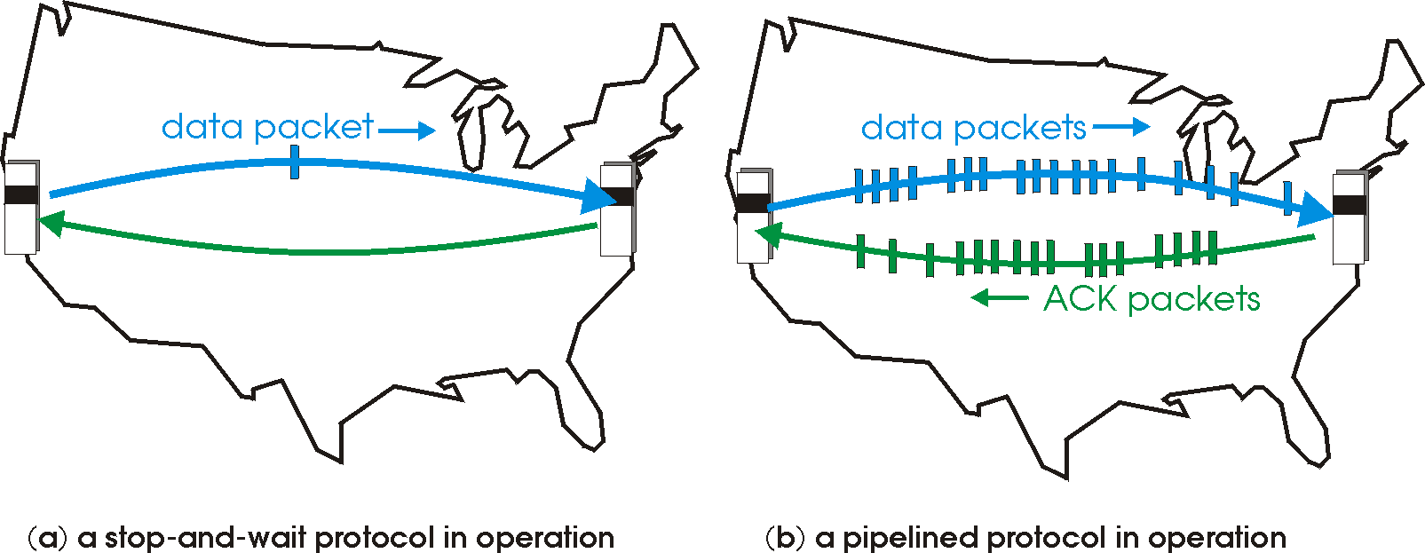

rdt3.0: pipelined protocols operation
pipelining: sender allows multiple, “in-flight”, yet-to-be-acknowledged packets
range of sequence numbers must be increased
buffering at sender and/or receiver

Slide 13
Pipelining: increased utilization
sender
receiver
first packet bit transmitted, t = 0
last bit transmitted, t = L / R
first packet bit arrives
RTT
last packet bit arrives, send ACK
last bit of 2nd packet arrives, send ACK
last bit of 3rd packet arrives, send ACK
ACK arrives, send next
packet, t = RTT + L / R
3-packet pipelining increases
utilization by a factor of 3!
Notes:
two generic forms of pipelined protocols: go-Back-N, selective repeat

Slide 14
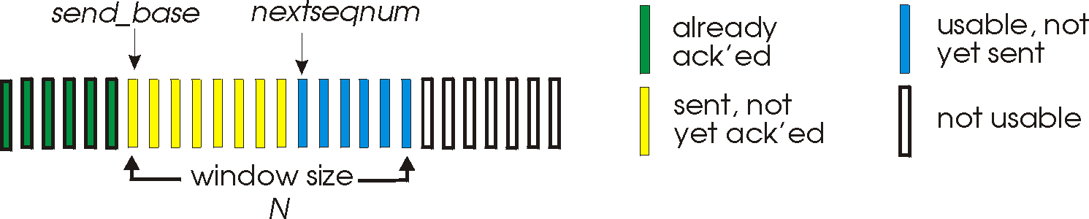
Go-Back-N: sender
sender: “window” of up to N, consecutive transmitted but unACKed pkts
k-bit seq # in pkt header
cumulative ACK: ACK(n): ACKs all packets up to, including seq # n
on receiving ACK(n): move window forward to begin at n+1
timer for oldest in-flight packet
timeout(n): retransmit packet n and all higher seq # packets in window
Notes:
window size of 14, 8 have been sent but are not yet acknowledged m 6 sequence numbers are available for us. In window, but no calls from above to use them.
Note – we’ll skip the Go-Back-N FSM specification you can check that out in powerpoint slides or book)
TCP uses cumulative ACK

Slide 15
Go-Back-N: receiver
ACK-only: always send ACK for correctly-received packet so far, with highest in-order seq #
may generate duplicate ACKs
need only remember rcv_base
on receipt of out-of-order packet:
can discard (don’t buffer) or buffer: an implementation decision
re-ACK pkt with highest in-order seq #
Receiver view of sequence number space:
received and ACKed
…
…
Out-of-order: received but not ACKed
rcv_base
Not received
Notes:
Note – we’ll skip the Go-Back-N FSM specification (actually it’s

Slide 16
Go-Back-N in action
sender window (N=4)
sender
receiver
0 1 2 3 4 5 6 7 8
send pkt0
send pkt1
send pkt2
send pkt3
(wait)
0 1 2 3 4 5 6 7 8
receive pkt0, send ack0
receive pkt1, send ack1
receive pkt3, discard,
(re)send ack1
0 1 2 3 4 5 6 7 8
X
0 1 2 3 4 5 6 7 8
loss
0 1 2 3 4 5 6 7 8
rcv ack0, send pkt4
0 1 2 3 4 5 6 7 8
rcv ack1, send pkt5
receive pkt4, discard,
(re)send ack1
ignore duplicate ACK
receive pkt5, discard,
(re)send ack1
pkt 2 timeout
0 1 2 3 4 5 6 7 8
send pkt2
send pkt3
send pkt4
send pkt5
0 1 2 3 4 5 6 7 8
0 1 2 3 4 5 6 7 8
rcv pkt2, deliver, send ack2
rcv pkt3, deliver, send ack3
rcv pkt4, deliver, send ack4
rcv pkt5, deliver, send ack5
0 1 2 3 4 5 6 7 8
Applets for Go-Back-N
https://computerscience.unicam.it/marcantoni/reti/applet/GoBackProtocol/goback.html
https://media.pearsoncmg.com/aw/ecs_kurose_compnetwork_7/cw/content/interactiveanimations/go-back-n-protocol/index.html
Notes:
Let’s skip FSM specification for GBN – check out the book or ppt – and let’s watch GBN sender and receivers in action.
Let assume a window size of 4. at t=0, sender sends packets 0, 1, 2 3, 4, and packet 2 will be lost
At the receiver:
Packet 0 received ACK0 generated
Packet 1 received ACK1 generated
Packet 2 is lost, and so when packet 3 is received, ACK 1 is sent – that’s the cumulative ACK, re-Acknowledging the receipt of packet 1. and in this implementation packet 3 is discarded

Slide 17
GBN: sender extended FSM
rdt_send(data)
First, check if window is full,
if not send and update variables
N is the window size
base=oldest unack’ed
nextseqnum=seqno of next pckt
if (nextseqnum < base+N) {
sndpkt[nextseqnum] = make_pkt(nextseqnum,data,chksum)
udt_send(sndpkt[nextseqnum])
if (base == nextseqnum)
start_timer
nextseqnum++
}
else
refuse_data(data)
Timer associated with oldest unacked
base == nextseqnum, when?
Λ
base=1
nextseqnum=1
timeout
On timeout resend all
unack’ed packets
Wait
start_timer
udt_send(sndpkt[base])
udt_send(sndpkt[base+1])
…
udt_send(sndpkt[nextseqnum-1])
Why wait?
rdt_rcv(rcvpkt)
&& corrupt(rcvpkt)
Λ
Cumulative ACKs, receiver only
ACKs when packets delivered
in order.
Here we need to update base
and stop timer if nothing to send
or restart if some pckts left
rdt_rcv(rcvpkt) &&
notcorrupt(rcvpkt)
base = getacknum(rcvpkt)+1
If (base == nextseqnum)
stop_timer
else
start_timer
Notes:
Section D (topic covered: 28-10-2021)

Slide 18
GBN: receiver extended FSM
default
udt_send(sndpkt)
rdt_rcv(rcvpkt)
&& notcurrupt(rcvpkt)
&& hasseqnum(rcvpkt,expectedseqnum)
Λ
Wait
extract(rcvpkt,data)
deliver_data(data)
sndpkt = make_pkt(expectedseqnum,ACK,chksum)
udt_send(sndpkt)
expectedseqnum++
expectedseqnum=1
sndpkt =
make_pkt(expectedseqnum-1,ACK,chksum)
ACK-only: always send ACK for correctly-received pkt with highest in-order seq #
may generate duplicate ACKs
need only remember expectedseqnum
out-of-order pkt:
discard (don’t buffer): no receiver buffering!
re-ACK pkt with highest in-order seq #

Slide 19
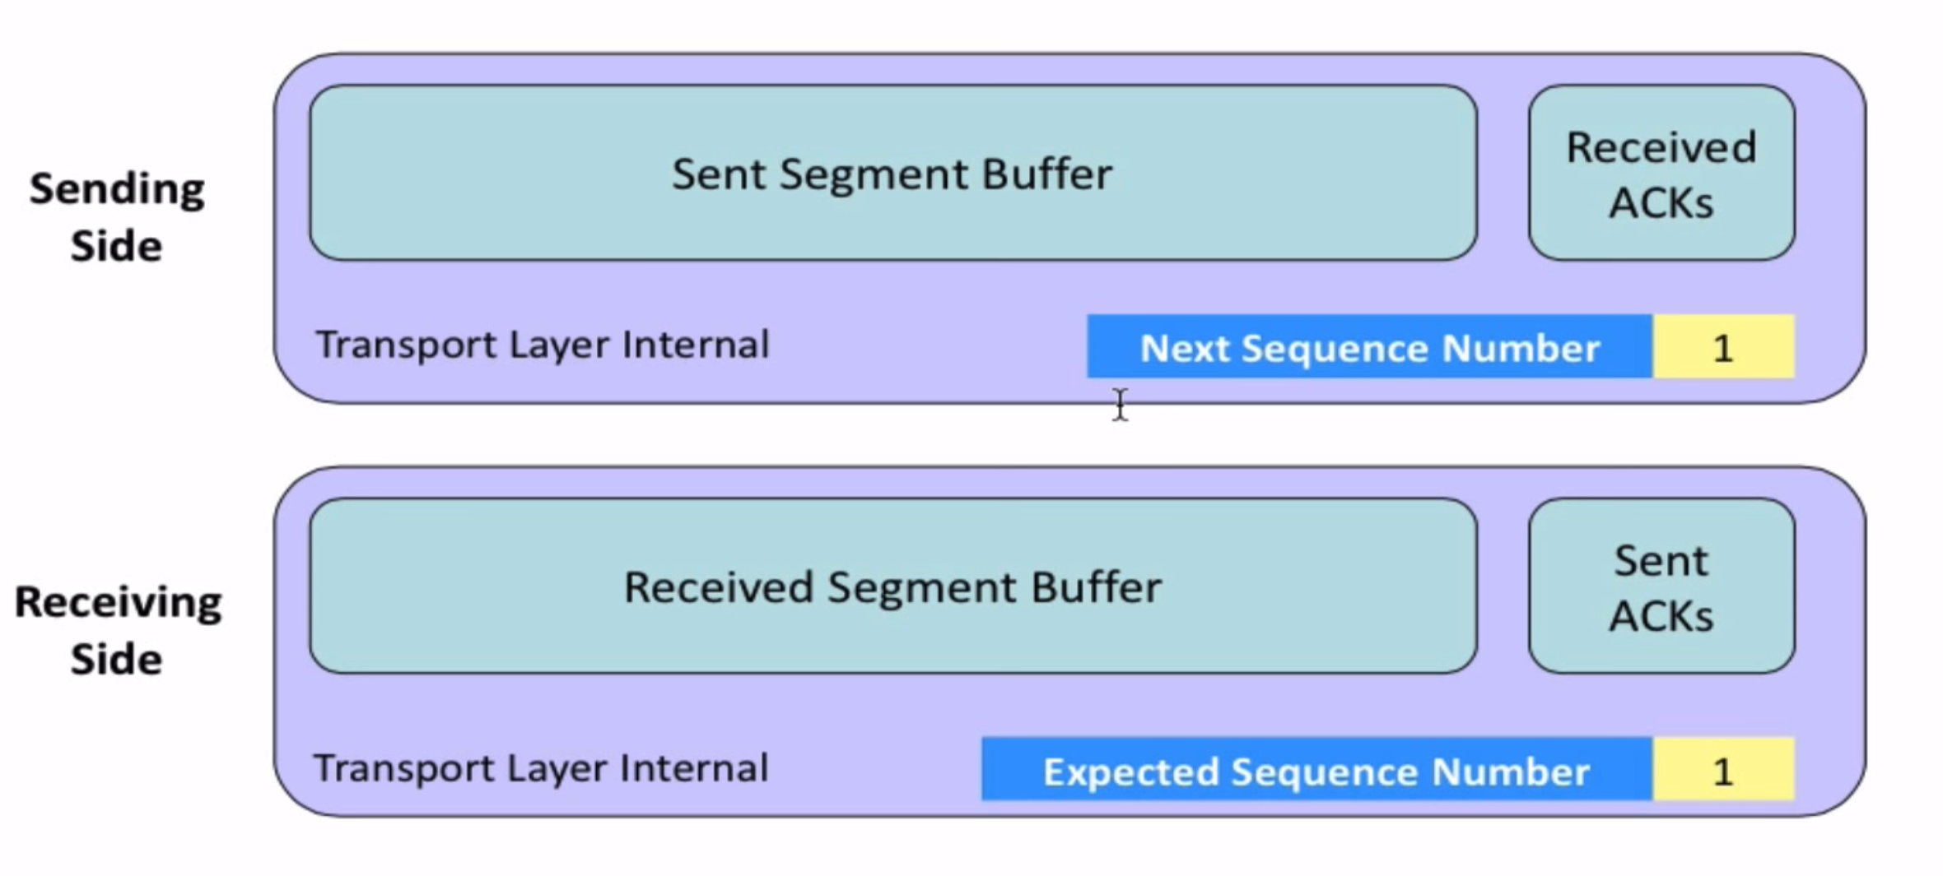
Go-Back-N

Slide 20
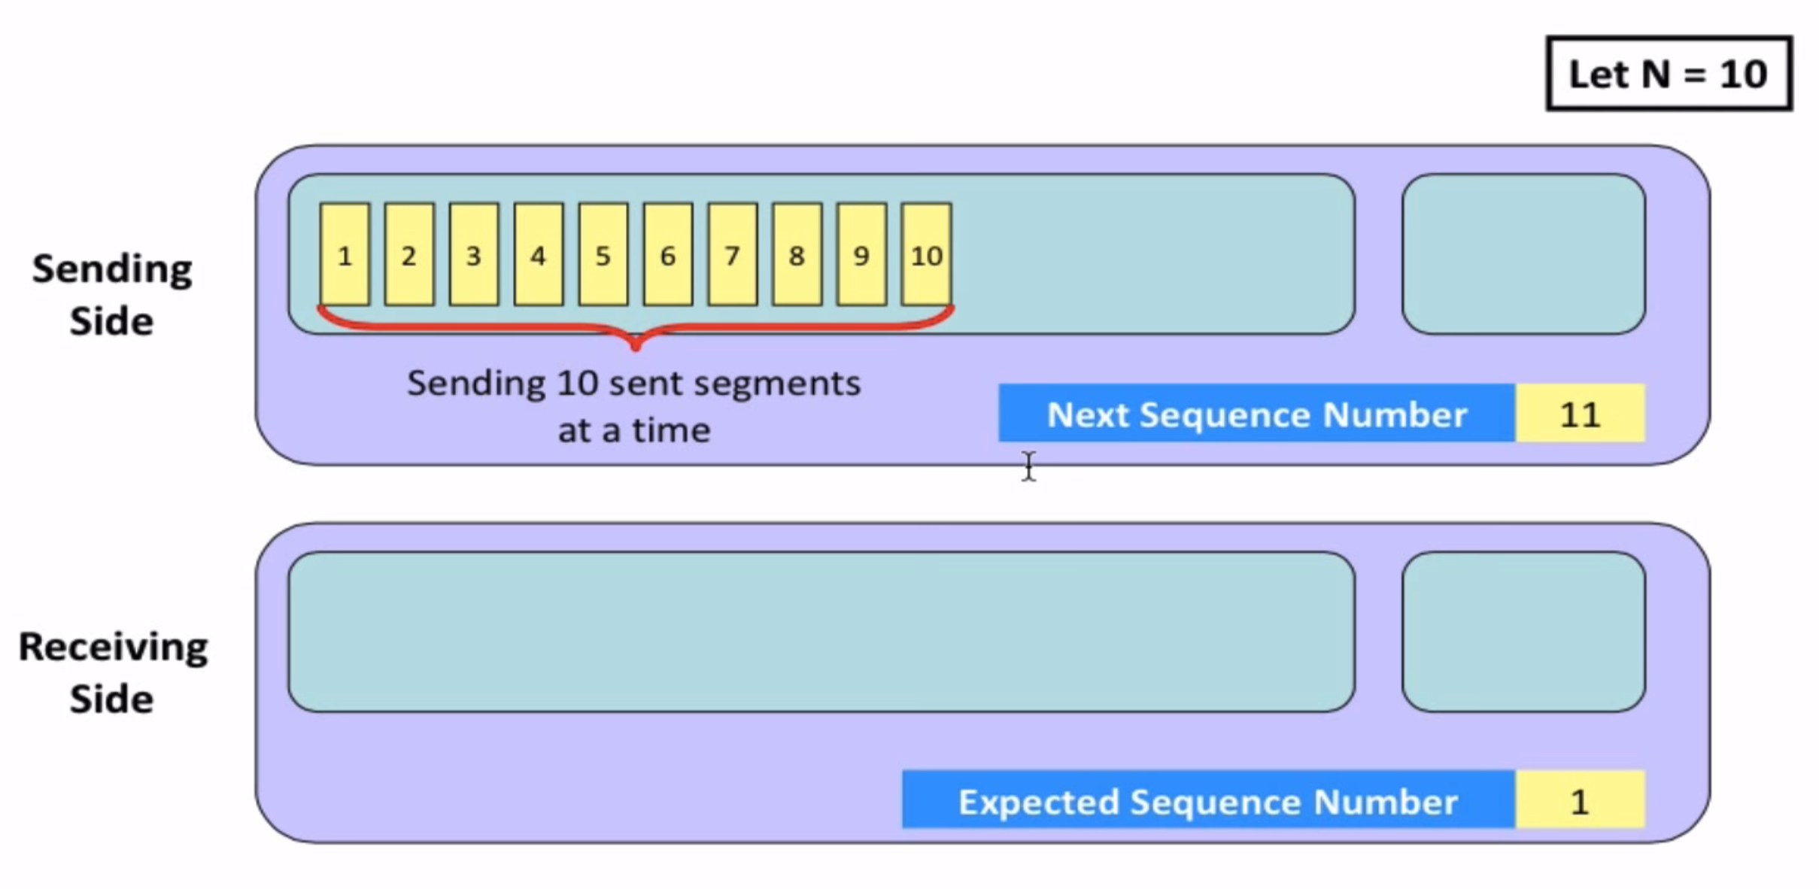
Go-Back-N

Slide 21
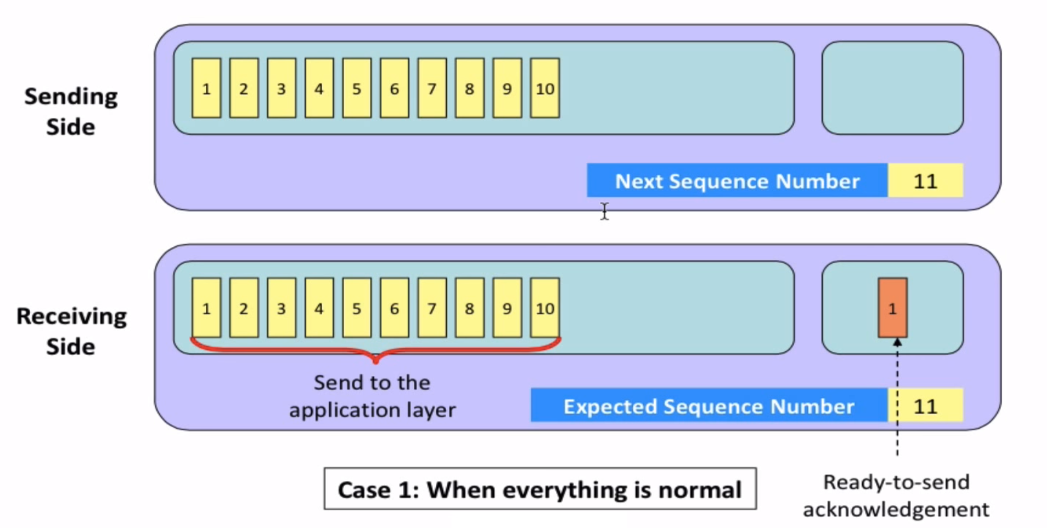
Go-Back-N

Slide 22
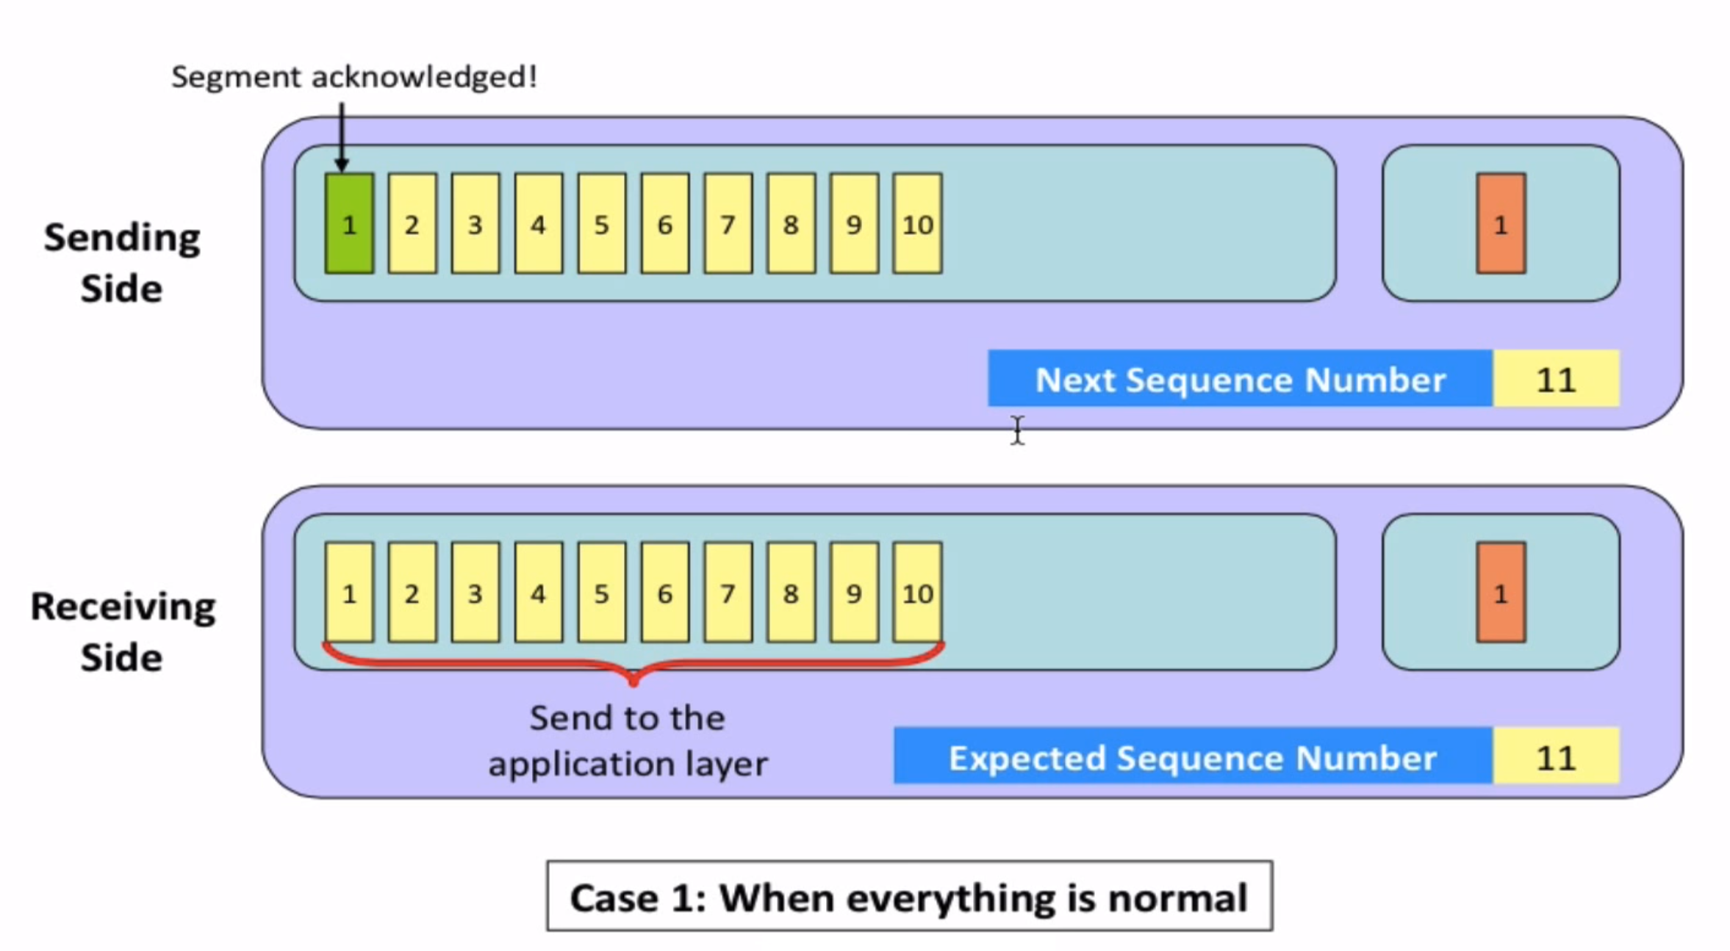
Go-Back-N

Slide 23
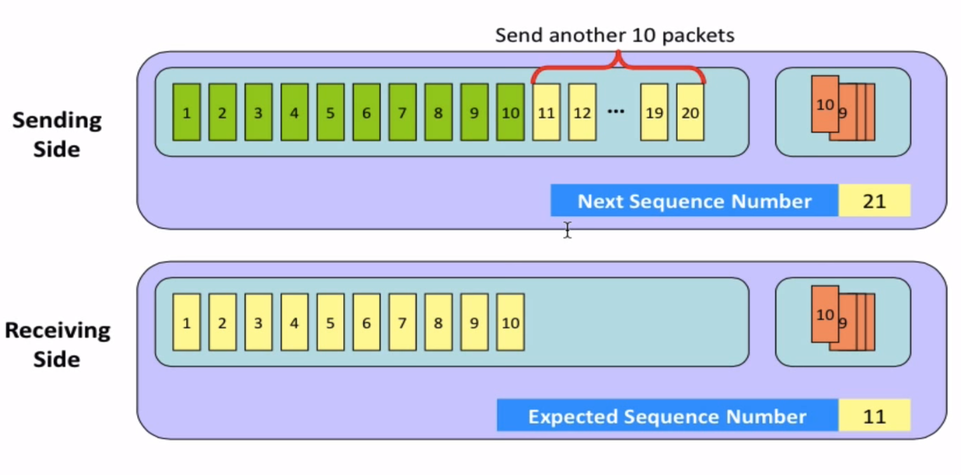
Go-Back-N

Slide 24
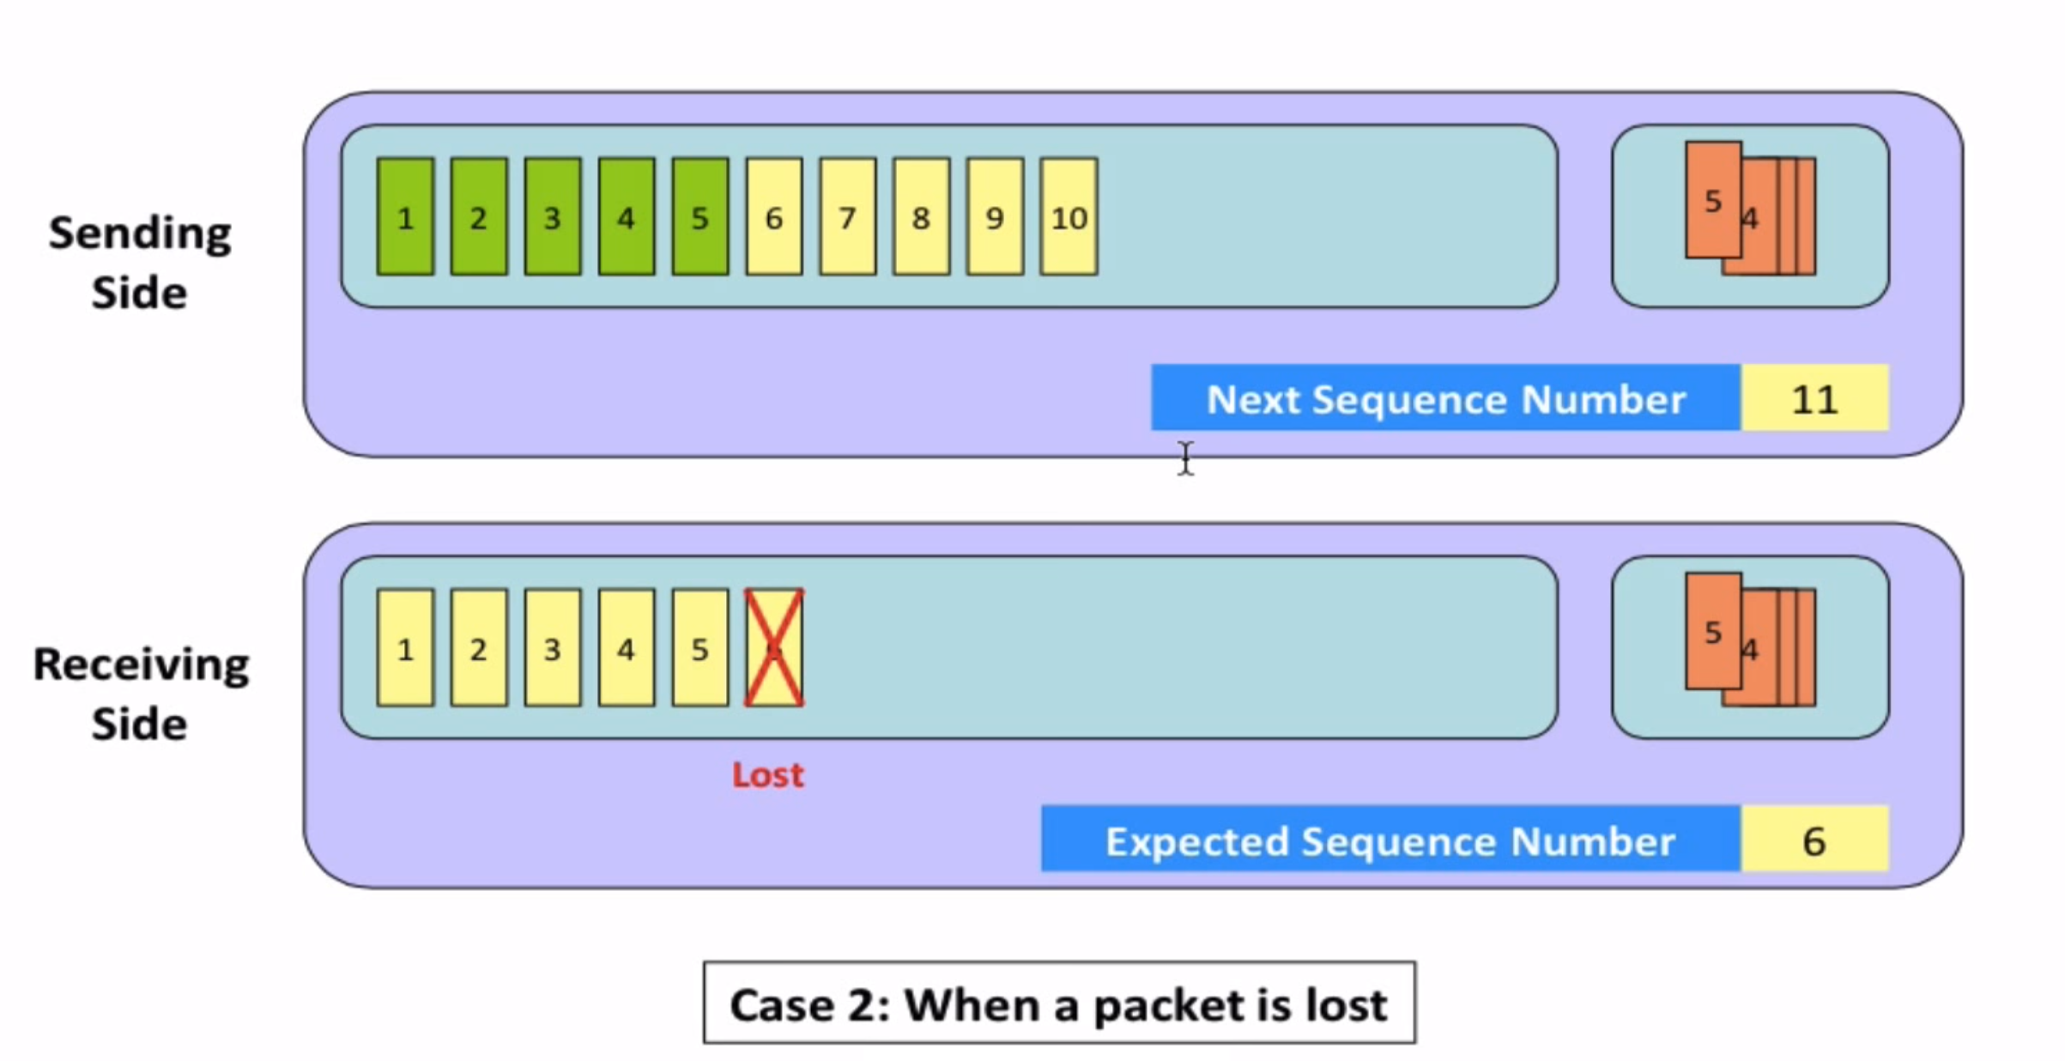
Go-Back-N

Slide 25
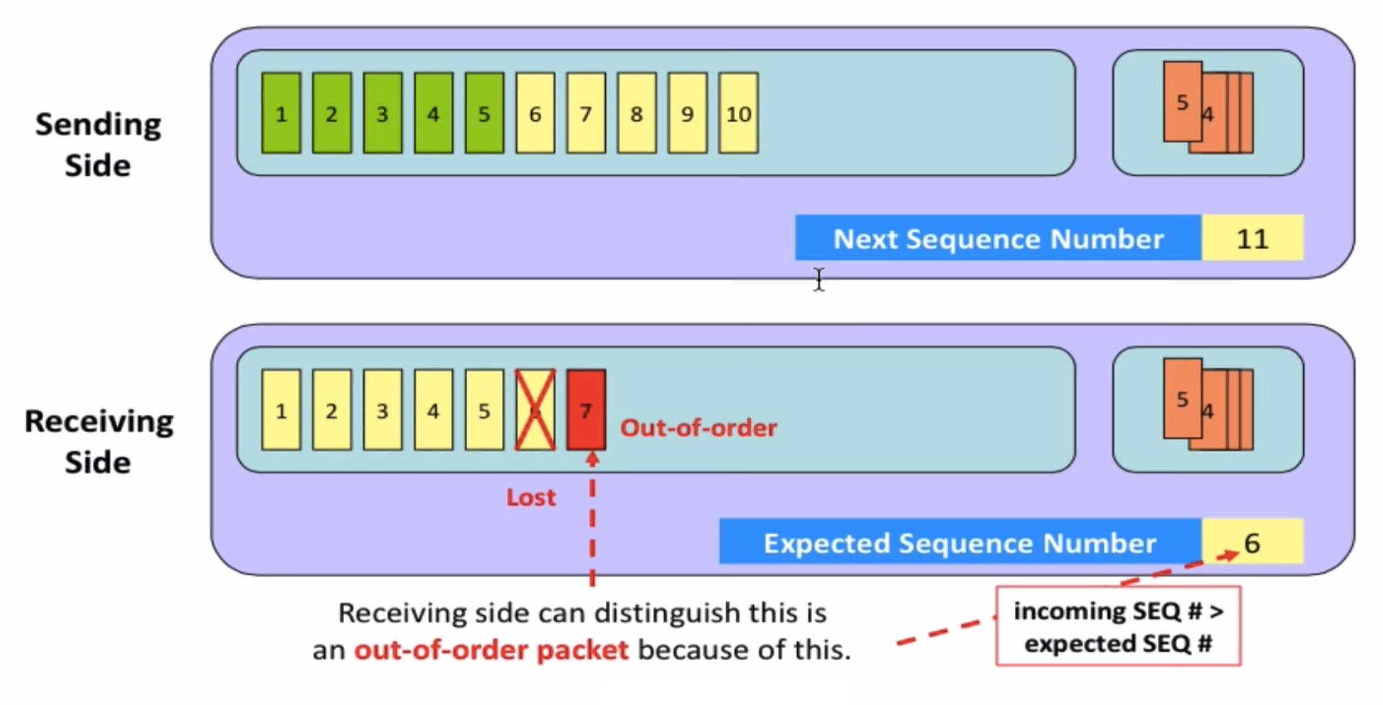
Go-Back-N

Slide 26
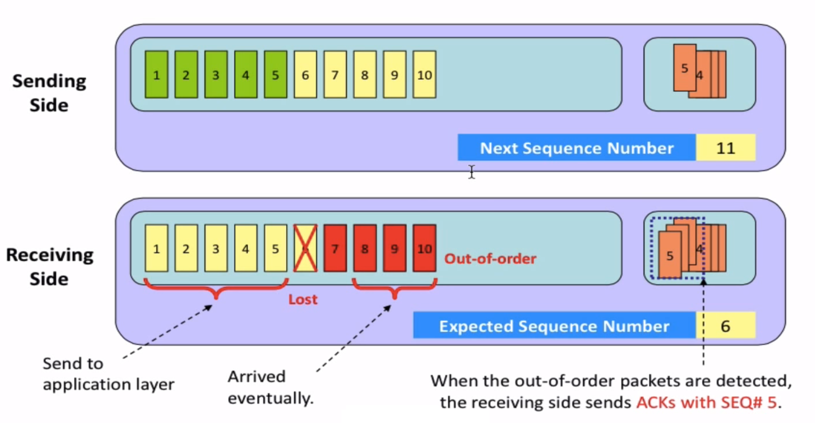
Go-Back-N

Slide 27
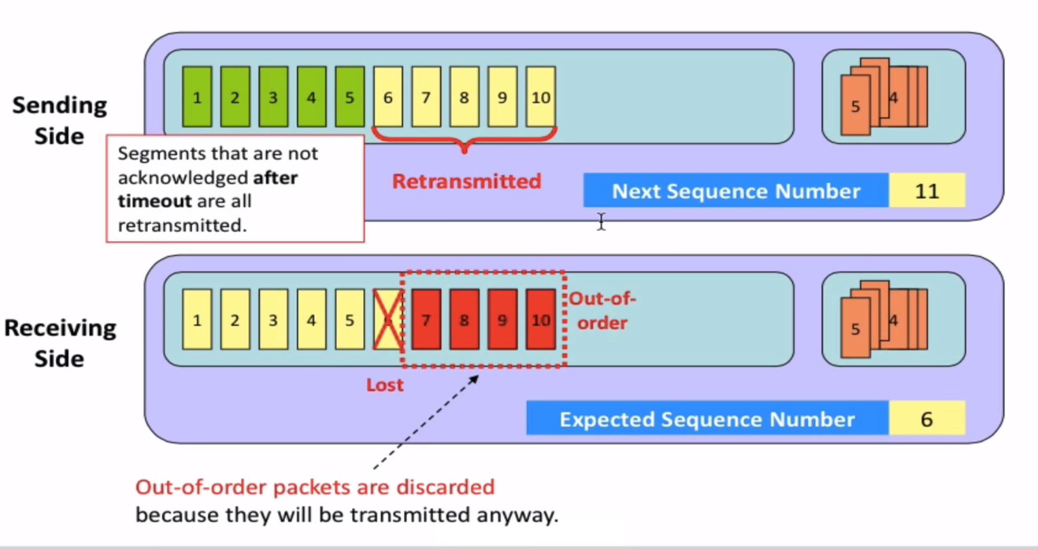
Go-Back-N

Slide 28
Go-Back-N
Why N? why not having an unbound window size?
Answer:
Having an unbound window size means to end up with an unbound number of unacknowledge segments
An unbound window size means bombarding the buffers on the network devices along the traffic path as well as the buffer on the destination

Slide 29
Selective repeat
receiver individually acknowledges all correctly received packets
buffers packets, as needed, for eventual in-order delivery to upper layer
sender times-out/retransmits individually for unACKed packets
sender maintains timer for each unACKed pkt
sender window
N consecutive seq #s
limits seq #s of sent, unACKed packets
Notes:
An important mechanism of GBN was the use of the cumulative acknowledgements, and as we mentioned, cumulative ACKs are used in TCP
An alternate ACK mechanism would be for the receiver to individually acknowledge specific packets as they are received. This mechanism is at the heart of the Selective repeat protocol.

Slide 30
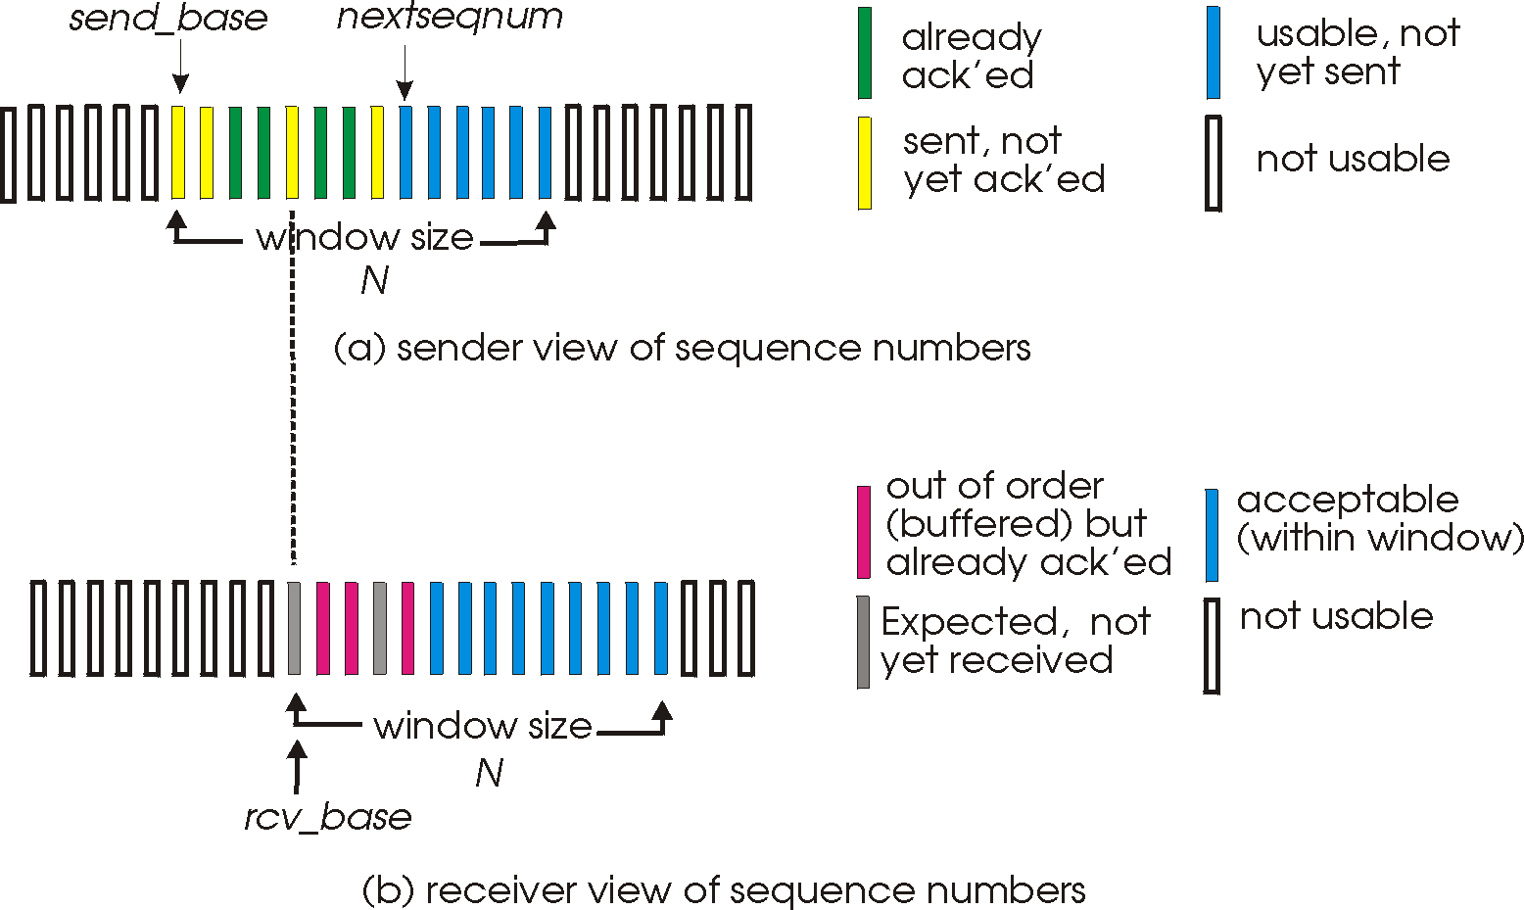
Selective repeat: sender, receiver windows

Slide 31
Selective repeat: sender and receiver
sender
receiver
data from above:
if next available seq # in window, send packet
timeout(n):
resend packet n, restart timer
ACK(n) in [sendbase, sendbase+N]:
mark packet n as received
if n smallest unACKed packet, advance window base to next unACKed seq #
packet n in [rcvbase, rcvbase+N-1]
send ACK(n)
out-of-order: buffer
in-order: deliver (also deliver buffered, in-order packets), advance window to next not-yet-received packet
packet n in [rcvbase-N,rcvbase-1]
ACK(n)
otherwise:
ignore
Notes:
Section E and F topic covered ( only theory is remaining) of this slide…
If the packet is in order, its data will be delivered, as will any buffered data that can now be delivered in order

Slide 32
Selective Repeat in action
sender window (N=4)
sender
receiver
0 1 2 3 4 5 6 7 8
send pkt0
send pkt1
send pkt2
send pkt3
(wait)
0 1 2 3 4 5 6 7 8
receive pkt0, send ack0
receive pkt1, send ack1
receive pkt3, buffer,
send ack3
0 1 2 3 4 5 6 7 8
X
0 1 2 3 4 5 6 7 8
loss
0 1 2 3 4 5 6 7 8
rcv ack0, send pkt4
0 1 2 3 4 5 6 7 8
rcv ack1, send pkt5
receive pkt4, buffer,
send ack4
record ack3 arrived
receive pkt5, buffer,
send ack5
pkt 2 timeout
0 1 2 3 4 5 6 7 8
send pkt2
(but not 3,4,5)
0 1 2 3 4 5 6 7 8
0 1 2 3 4 5 6 7 8
rcv pkt2; deliver pkt2,
pkt3, pkt4, pkt5; send ack2
0 1 2 3 4 5 6 7 8
Q: what happens when ack2 arrives?
Applets for Selective repeat:
https://computerscience.unicam.it/marcantoni/reti/applet/SelectiveRepeatProtocol/selRepProt.html
https://media.pearsoncmg.com/aw/ecs_kurose_compnetwork_7/cw/content/interactiveanimations/selective-repeat-protocol/index.html

Slide 33
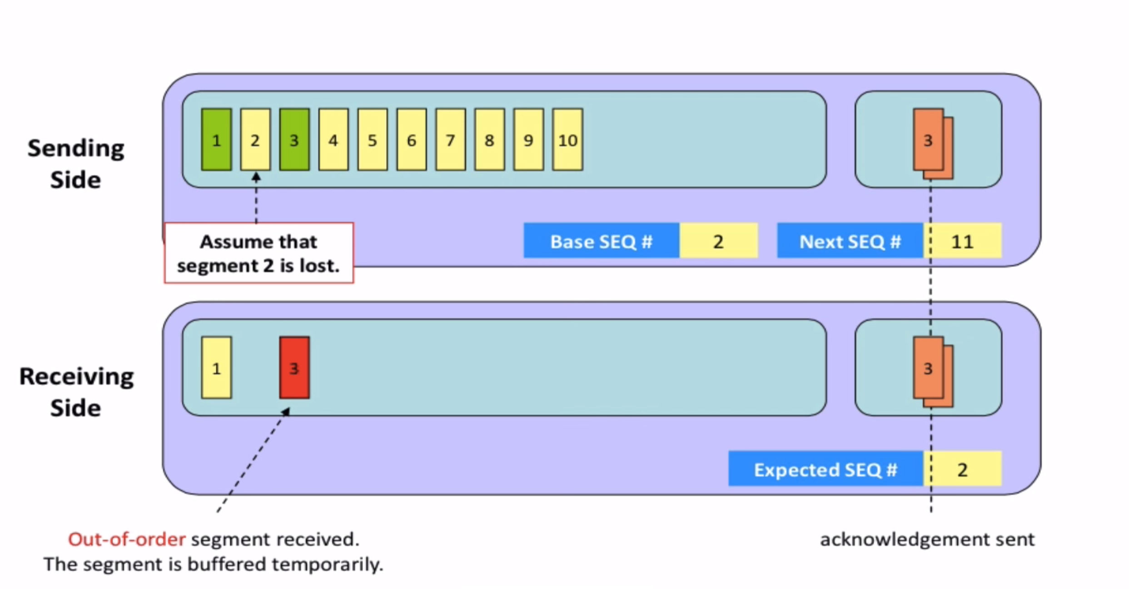
Selective repeat

Slide 34
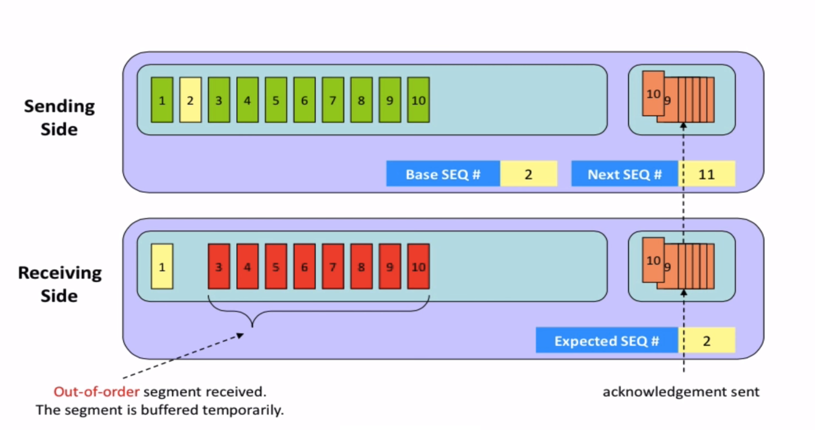
Selective repeat

Slide 35
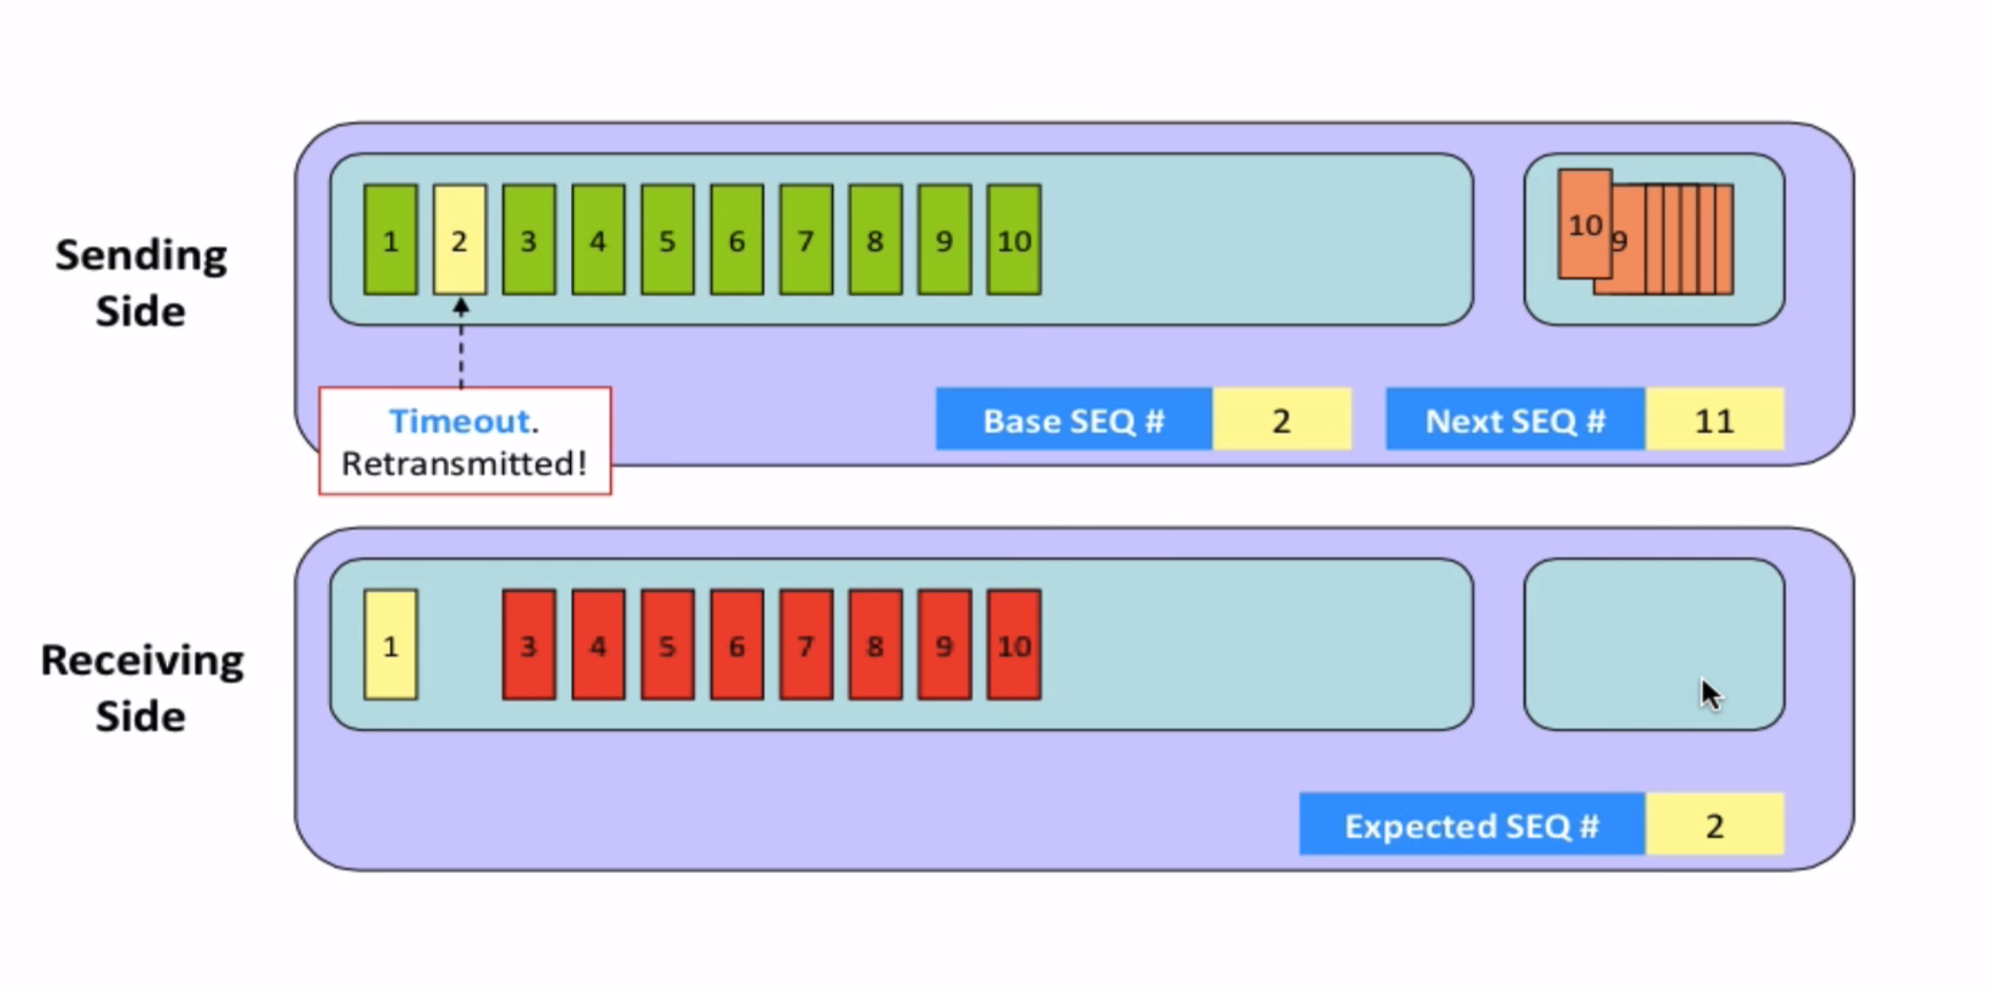
Selective repeat

Slide 36
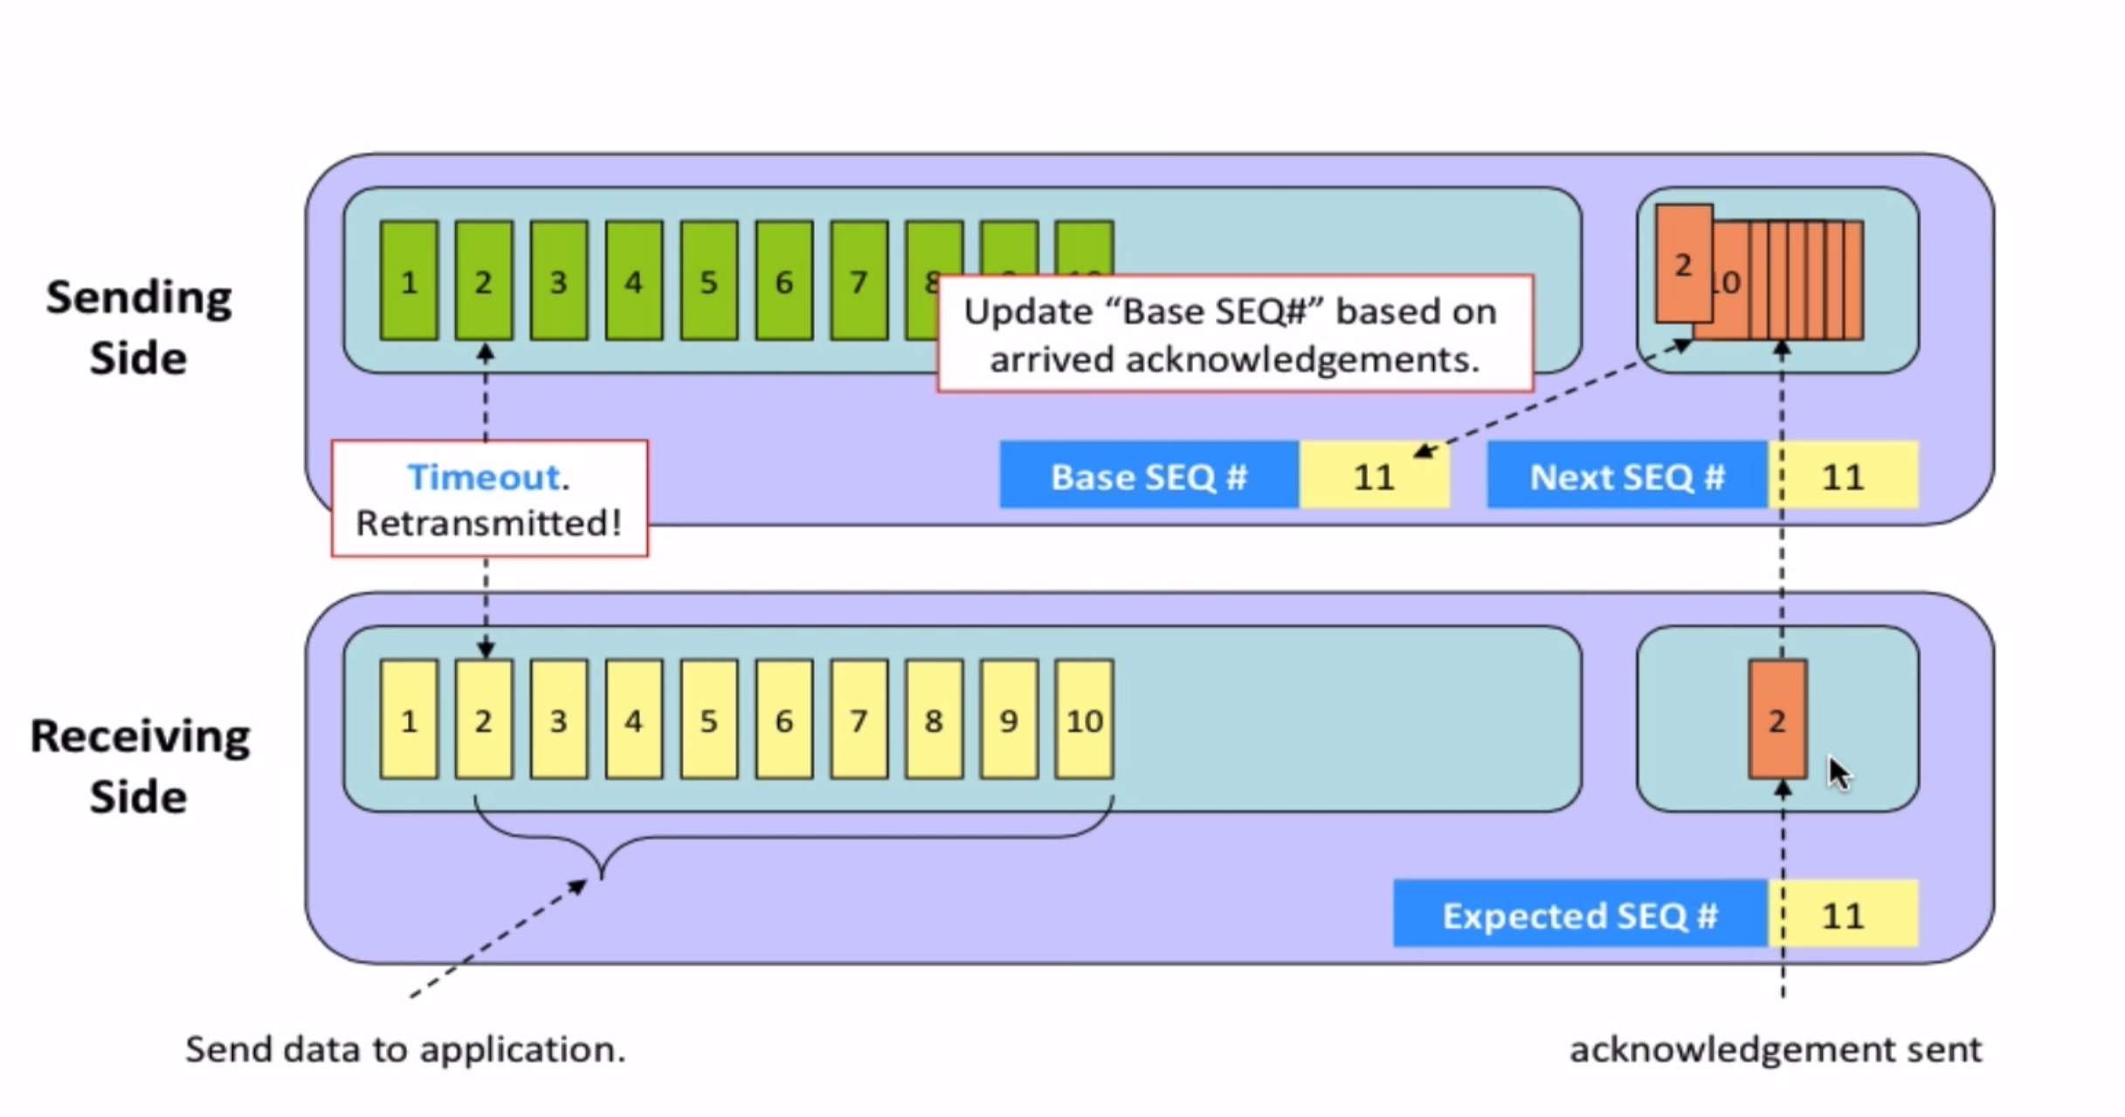
Selective repeat

Slide 37
Selective repeat: a dilemma!
sender window
(after receipt)
receiver window
(after receipt)
0 1 2 3 0 1 2
pkt0
0 1 2 3 0 1 2
pkt1
0 1 2 3 0 1 2
0 1 2 3 0 1 2
pkt2
0 1 2 3 0 1 2
example:
seq #s: 0, 1, 2, 3 (base 4 counting)
window size=3
0 1 2 3 0 1 2
0 1 2 3 0 1 2
pkt3
X
0 1 2 3 0 1 2
pkt0
will accept packet
with seq number 0
(a) no problem
0 1 2 3 0 1 2
pkt0
0 1 2 3 0 1 2
pkt1
0 1 2 3 0 1 2
0 1 2 3 0 1 2
pkt2
X
0 1 2 3 0 1 2
X
0 1 2 3 0 1 2
X
timeout
retransmit pkt0
0 1 2 3 0 1 2
pkt0
will accept packet
with seq number 0
(b) oops!

Slide 38

Selective repeat: a dilemma!
sender window
(after receipt)
receiver window
(after receipt)
0 1 2 3 0 1 2
pkt0
0 1 2 3 0 1 2
pkt1
0 1 2 3 0 1 2
0 1 2 3 0 1 2
pkt2
0 1 2 3 0 1 2
example:
seq #s: 0, 1, 2, 3 (base 4 counting)
window size=3
0 1 2 3 0 1 2
0 1 2 3 0 1 2
pkt3
X
0 1 2 3 0 1 2
receiver can’t see sender side
receiver behavior identical in both cases!
something’s (very) wrong!
pkt0
will accept packet
with seq number 0
(a) no problem
Q: what relationship is needed between sequence # size and window size to avoid problem in scenario (b)?
pkt0
0 1 2 3 0 1 2
0 1 2 3 0 1 2
pkt1
0 1 2 3 0 1 2
0 1 2 3 0 1 2
pkt2
X
0 1 2 3 0 1 2
X
0 1 2 3 0 1 2
X
timeout
retransmit pkt0
0 1 2 3 0 1 2
pkt0
A: Window size should be less than or
equal to half the sequence number.
will accept packet
with seq number 0
(b) oops!
Notes:
Window size should be less than or equal to half the sequence number in SR protocol. This is to avoid packets being recognized incorrectly. If the size of the window is greater than half the sequence number space, then if an ACK is lost, the sender may send new packets that the receiver believes are retransmissions.
Packets reordering:
Because sequence numbers may be reused, some care must be taken to guard against such duplicate packets
In practice, we need to ensure that a sequence number is not reused until the sender is “sure” that any previously sent packets with sequence number x are no longer in the network.
How it can be done?
This is done by assuming that a packet cannot “live” in the network for longer than some fixed maximum amount of time.
A maximum packet lifetime of approximately three minutes is assumed in the TCP extensions

Slide 39
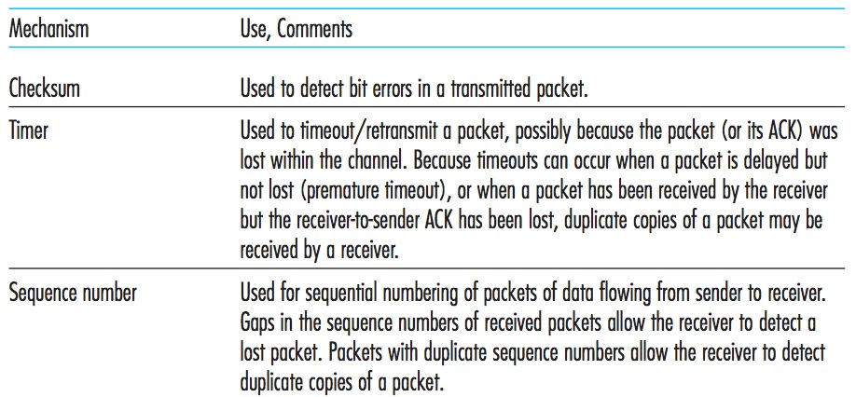
Summary

Slide 40
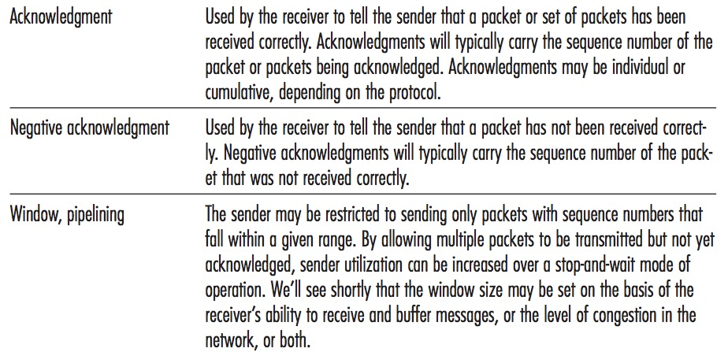
Summary

Slide 41
Chapter 3: roadmap
Transport-layer services
Multiplexing and demultiplexing
Connectionless transport: UDP
Principles of reliable data transfer
Connection-oriented transport: TCP
segment structure
reliable data transfer
flow control
connection management
Principles of congestion control
TCP congestion control

Slide 42
TCP: overview RFCs: 793,1122, 2018, 5681, 7323
point-to-point:
one sender, one receiver
reliable, in-order byte stream:
no “message boundaries"
full duplex data:
bi-directional data flow in same connection
MSS: maximum segment size
cumulative ACKs
pipelining:
TCP congestion and flow control set window size
connection-oriented:
handshaking (exchange of control messages) initializes sender, receiver state before data exchange
flow controlled:
sender will not overwhelm receiver
Notes:
Typical MSS is 1460 bytes

Slide 43
TCP sequence numbers, ACKs
outgoing segment from sender
Sequence numbers:
byte stream “number” of first byte in segment’s data
source port #
dest port #
sequence number
acknowledgement number
rwnd
checksum
urg pointer
window size
N
Acknowledgements:
seq # of next byte expected from other side
cumulative ACK
sender sequence number space
sent
ACKed
sent, not-yet ACKed
(“in-flight”)
usable
but not
yet sent
not
usable
Q: how receiver handles out-of-order segments
A: TCP spec doesn’t say, - up to implementor
outgoing segment from receiver
source port #
dest port #
sequence number
acknowledgement number
A
rwnd
checksum
urg pointer

Slide 44
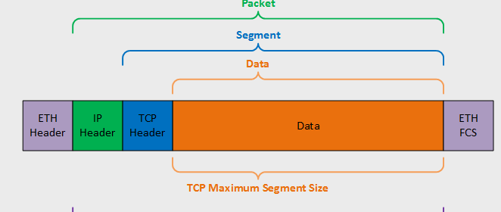
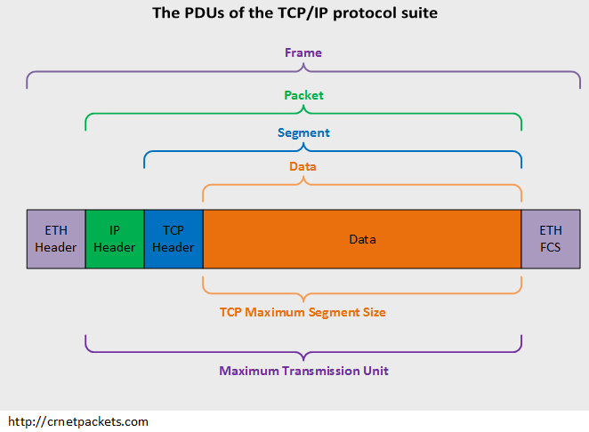
MSS and MTU
The maximum amount of data in a segment is limited by the maximum segment size (MSS)
The MSS is typically set by first determining (the so-called maximum transmission unit, MTU)
MSS+ TCP/IP header when encapsulated in an IP datagram) will fit into a single link-layer frame
Notes:
the length of the largest link-layer frame that can be sent by the local sending host
FCS: Frame check sequence
ETH: Ethernet

Slide 45
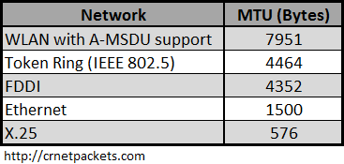
MSS and MTU
The MSS limits the maximum size of a segment’s data field
It is more or less a physical limit
It is specified for each link separately
MTU reduction can occur elsewhere in the communication path
Notes:
Fiber Distributed Data Interface (FDDI)
Fiber Distributed Data Interface is a standard for data transmission in a local area network. It uses optical fiber as its standard underlying physical medium, although it was also later specified to use copper cable, in which case it may be called CDDI, standardized as TP-PMD, also referred to as TP-DDI.
MAC Service Data Unit (MSDU)
X.25 is an ITU-T standard protocol suite for packet-switched data communication in wide area networks. It was originally defined by the International Telegraph and Telephone Consultative Committee in a series of drafts and finalized in a publication known as The Orange Book in 1976.

Slide 46


Thank You All
☺
?
A note on the origin of these ppt slides:
All material copyright 1996-2020 J.F Kurose and K.W. Ross, All Rights Reserved
These slides are freely provided by the book authors and it represents a lot of work on their part. We would like to thank J.F Kurose and K.W. Ross.
Transport Layer: 3-150
Notes:
Section F and G ended

